Slide 1
Disease Prediction and AI-Based Prescription Generator
N190375- K. jyothi sai
N190370-B. vemesh
N190245-A.v. vamsi
N190495 -Sk.jasmin
N191035-S. sravani

Slide 2
Table of Contents
Abstract
Introduction
Advantages of the Proposed System
Existing System Drawbacks
Proposed Methodology
Technologies used
Flowchart
Use Case and Activity diagrams
Observations
Future Work
Conclusion

Slide 3
Abstract
This project presents a Disease Prediction System that leverages machine learning algorithms to predict diseases based on user-input symptoms and provides detailed prescriptions using Google’s Gemini AI. The system combines structured medical datasets with trained models like Random Forest to identify diseases accurately. The integrated Streamlit interface allows for real-time prediction and feedback, making it user-friendly and interactive. Additionally, the project incorporates AI-generated medical advice, enhancing its value as a decision support tool in healthcare.

Slide 4
Introduction
Healthcare professionals often encounter challenges in early and accurate disease diagnosis due to overlapping symptoms. This project addresses this problem by creating a web-based application that uses machine learning to predict diseases from symptoms. Users select symptoms from a predefined list, and the system outputs the most likely disease along with AI-generated advice, including potential causes, prescriptions, and dietary recommendations. This solution is designed to support early diagnosis and self-awareness, especially in remote or underserved regions.

Slide 5
Advantages of the Proposed System
Comprehensive Healthcare Guidance: users receive not only disease predictions but also prescriptions and causal explanations, enhancing their healthcare experience.
Improved Accessibility: An interactive AI interface simplifies the process, making healthcare information accessible without requiring medical appointments.

Slide 6
Early Detection and Action: Immediate responses and suggestions allow for earlier interventions, which can prevent conditions from worsening.
User-Friendly Interface: The use of a generative model creates an easy-to-use, conversational experience that gives personalized medical advice in simple language, making it accessible for people without a medical background.

Slide 7
Existing System Drawbacks
Current symptom-based disease prediction systems often fail to integrate follow-up resources, such as prescription guidance or educational insights on disease causes. Users receive a diagnosis or prediction but lack information on managing or understanding their condition. This leaves them uncertain about the next steps in their healthcare journey.

Slide 8
Proposed Methodology
Data Collection:Uses two datasets (Training.csv and Testing.csv) containing symptoms and corresponding diseases.
Preprocessing:Converts categorical disease names into numerical values and drops unnecessary columns.
Model Training:Applies RandomForestClassifier on the training data for high accuracy predictions.

Slide 9
Model Evaluation: Splits the dataset to test accuracy and saves the trained model.
Prediction: Accepts user-selected symptoms, converts them into binary vectors, and predicts the disease using the trained model.
AI Integration: Uses Gemini API to generate cause, treatment, and diet plans for the predicted disease.
UI Development: Streamlit-based web app provides an intuitive user interface for symptom input and result display.

Slide 10
Technologies Used
Python: Core programming language.
Streamlit: Used to build the interactive web interface.
Pandas & NumPy: For data manipulation and preprocessing.
Scikit-learn: For training and evaluating machine learning models (Random Forest, Decision Tree, Naive Bayes).

Slide 11
Joblib: To save and load trained models efficiently.
Google Generative AI (Gemini API): To generate disease-specific prescriptions and advice.
dotenv: To securely manage API keys and environment variables.

Slide 12
Models Used
Decision Tree: A Decision Tree splits data based on feature values to make predictions, creating a tree-like structure. It's easy to interpret but prone to overfitting, especially with deep trees.
Random Forest:Random Forest builds multiple Decision Trees on random data subsets and combines their predictions. It improves accuracy and reduces overfitting but is computationally expensive

Slide 13
Naive Bayes: Supervised machine learning algorithm used for classification tasks, based on Bayes' Theorem. It assumes that all features are independent and equally contribute to the outcome, which is why it's called "naive." Despite its simplicity, it performs well, especially with large datasets and real-world applications.
Gemini (Google Generative AI): To generate personalized medical advice.

Slide 14
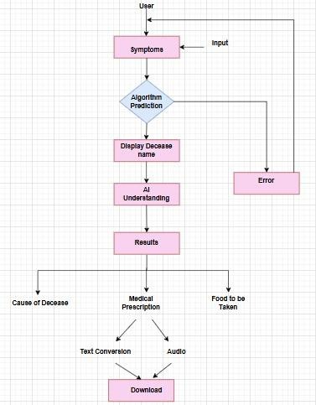
Flow Chart

Slide 15
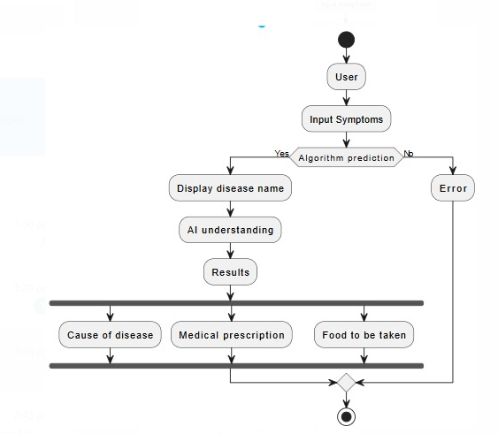
Activity Diagram

Slide 16
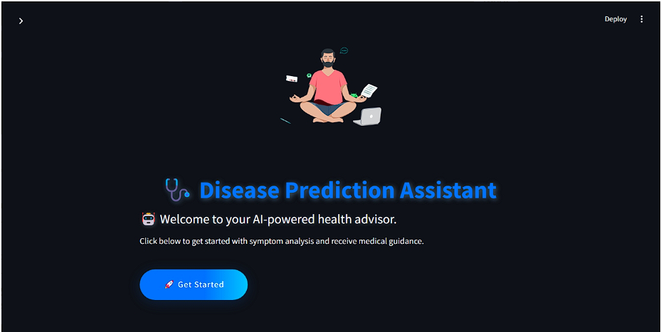
Sample outputs

Slide 17
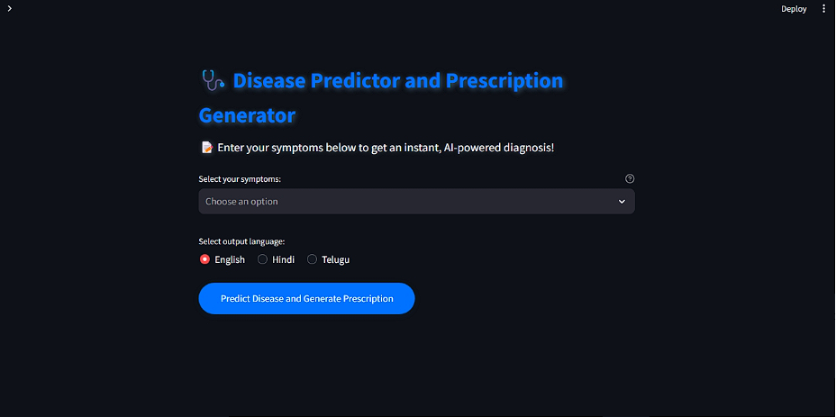

Slide 18
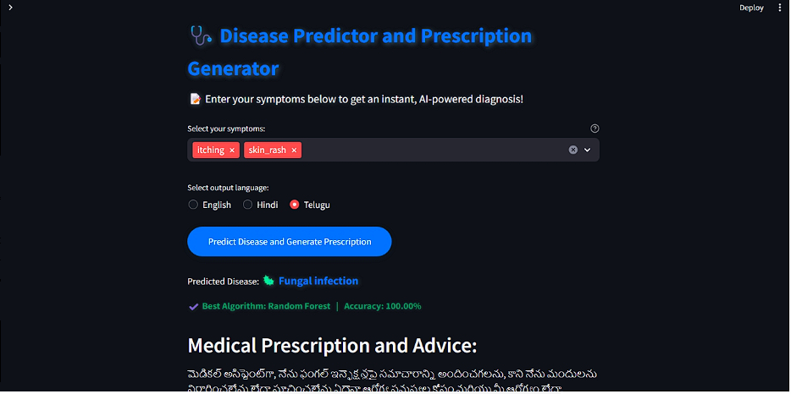

Slide 19
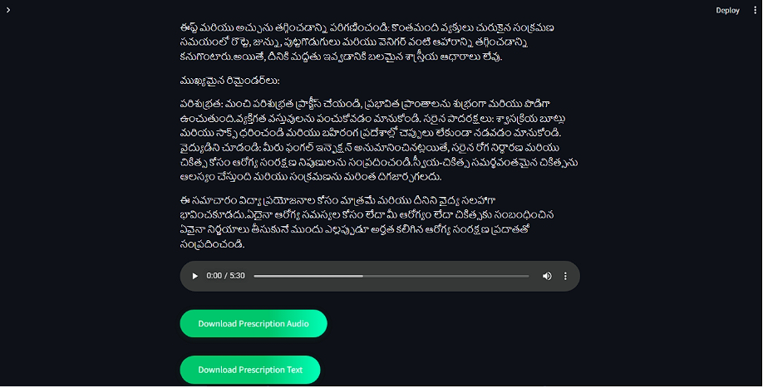

Slide 20
Observation
The Random Forest model achieved an accuracy of ~90% to 95%, indicating high performance in multi-class classification.
The system was able to handle a large number of symptoms (over 130) and multiple diseases.
Users received not only disease predictions but also actionable insights, enhancing its real-world applicability.

Slide 21
The UI was designed to be simple, responsive, and visually appealing with custom styling.
Integration of Gemini for prescriptions significantly added to the system's practicality and depth.

Slide 22
Future Work
Moving the system to the cloud would allow it to handle more users and larger data at the same time. Adding a feature where the model updates itself with new data without starting from scratch can save time. Automating data cleaning and preparation would make the system more accurate and easier to use. Lastly, using advanced hardware like GPUs can make the system process information much faster.

Slide 23
Conclusion
This project successfully demonstrates how machine learning and generative AI can be integrated to assist in healthcare. By predicting diseases based on symptoms and providing AI-generated prescriptions, the system bridges a crucial gap between symptom detection and actionable healthcare advice. It can serve as a valuable support tool for both patients and healthcare professionals, especially in settings with limited medical resources. Future enhancements could include real-time patient data integration, multilingual support, and more complex symptom-disease relationships through deep learning.

Slide 24
THANK YOU

